Slide 1

Experiences in developing an Agile Knowledge Environment
Presented by
Rohit Mital
June 9, 2015
www.sgt-inc.com

Slide 2

SGT and Knowledge Management(KM)
As a Service delivery organization, capturing and using best practice knowledge from prior engagements is why knowledge management is important to us
Privately held company founded in 1994
Grown organically 40-fold since its founding
Mid-tier provider of engineering and professional services
2,500+ employees
30 Active prime contracts with NASA, NOAA, DOT, DOI and DOD
Offices in over 25 locations
Core competencies in:
Engineering and integration services
Mission-critical Information Systems
Scientific and data analysis services

Slide 3
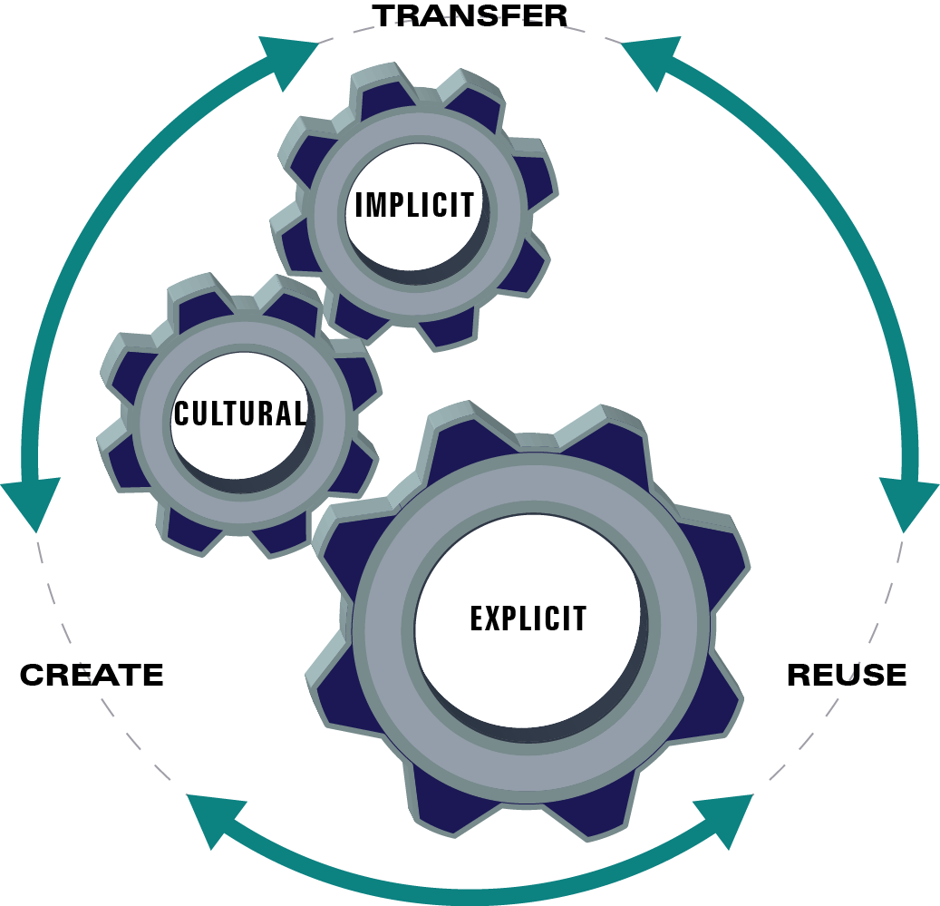
Types of Knowledge
Explicit knowledge
Articulable and transmittable in formal, systematic language.
Explicit knowledge can be captured persistently and communicated to others.
Implicit or tacit knowledge
Embedded in individual experience and involves intangible factors such as personal belief, perspectives and value systems
How do we capture this?
Cultural knowledge
Consists of informal assumptions, beliefs, relationships, norms, values etc.
It is usually hard to verbalize.
Graphic concept adapted from Gartner

Slide 4
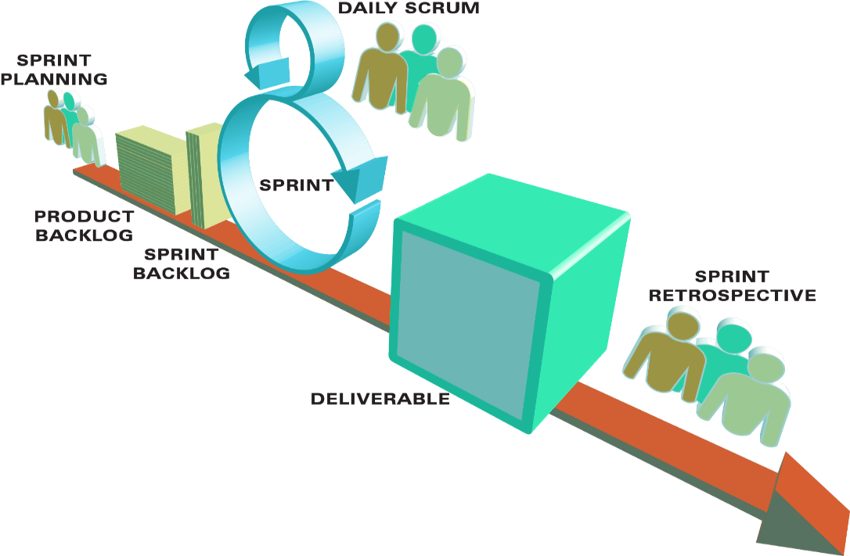
Agile applied to KM
Knowledge sharing is encouraged by several practices:
Cross-functional teams
Release and iteration planning
Daily Scrum meetings
Retrospectives

Slide 5
Agile KM Manifesto
Agile Software Manifesto | Agile KM Manifesto
Individuals and interactions over processes and tools | Individuals and relationships over tools
Working software over comprehensive documentation | Good enough over perfect content
Customer collaboration over contract negotiation | Collaboratively authored over editorial workflow
1
2
3

Slide 6
What are we doing today?
Focusing on the individual as the source of expertise and knowledge rather than obsessing over the knowledge itself.
Individuals and relationships Expertise directory consisting of Chiefs/Fellows/SME/Task Leads
Good enough Knowledge capture using various tools and media channels
Collaboratively authored Move from traditional collaboration to communities such as the Innovation Center
1
2
3

Slide 7
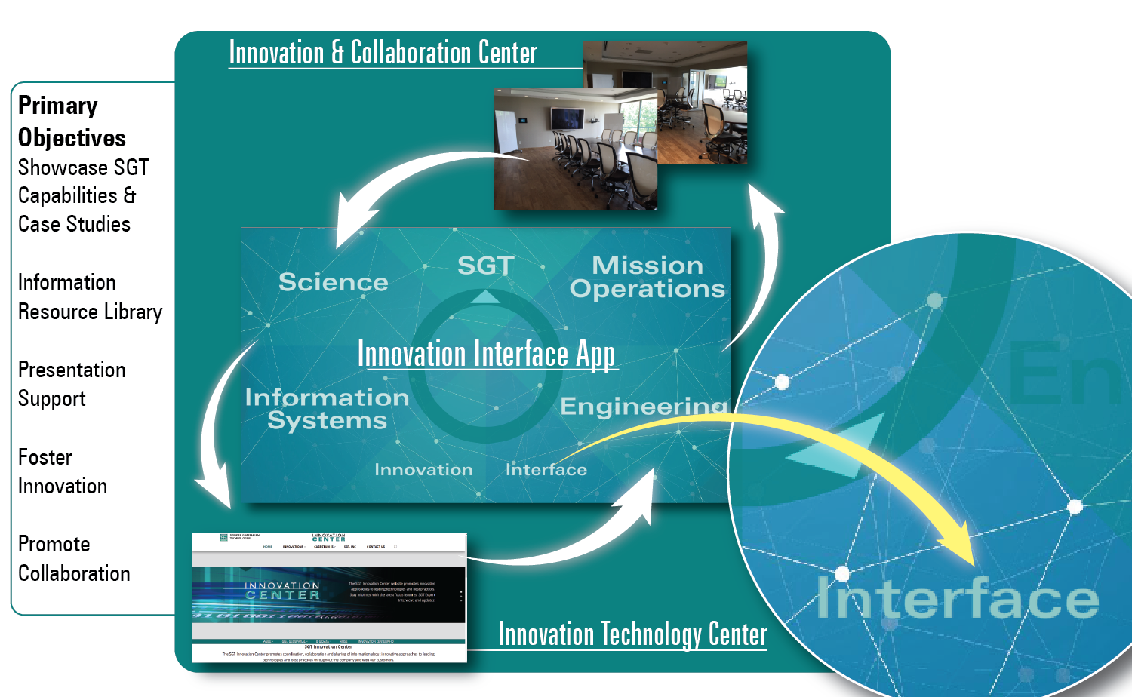
Innovation Center
Knowledge Management

Slide 8
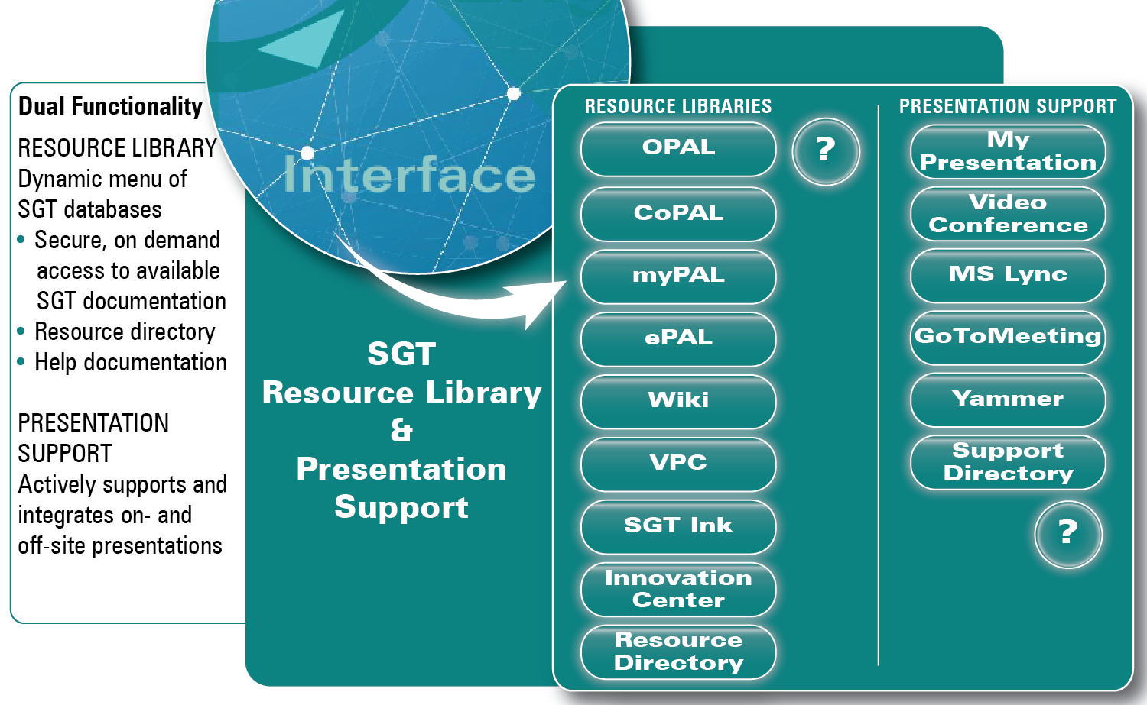
Innovation Center Interfaces

Slide 9
Challenges encountered
Motivating people
Security
Up-to-date and relevant
Ownership
Metrics

Slide 10
Lessons learned
Knowledge, learning and sharing come from people and their relationships with one another
Deliver “good enough” content frequently
Use multiple media channels to share information
Unless the knowledge gets reused, there is no point in having it
Don’t forget the consumers of knowledge

